Slide 1
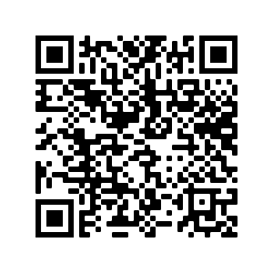
betkosol
Heb je de enquête (< 3 min.) al ingevuld? Scan de QR-code of ga via de link op Ufora.

Slide 2
RESULTS

Slide 3
RESULTS
A total of 82 respondents
PARTICIPANTS | NUMBER
16-20 | 26
21-25 | 55
26-30 | 0
Over 30 | 1

Slide 4
RESULTS
2. Have you ever benefited from European funds?
87% No – 13% Yes (80% Erasmus + - 10% Free Train Tickets and 10% Scholarship)
All in the range 21-25 with one exception (18-20: Erasmus+)

Slide 5
RESULTS
3. National Financial interest
72% yes – 28% no
Worth of protection:
85,2% yes – 14,8 % no peculiar: one student considers it exists but it is not worth to be protected and one other considers it does not exist but it is nevertheless worth to be protected

Slide 6
RESULTS
4. EU financial interest:
Results are similar to both questions: 82 till 83% states yes and it’s worth to be protected – 17-18% considers that it does not exist

Slide 7
RESULTS
5. EU Institutions
90,4% considers that the there are EU institutions protecting it while 9,6% states that this does not exist
The question which institutions deal with it, is more fragemented:
53,6% ECB
23,2% OLAF/Eppo
- 14,5% Eur. Parliament
- 8,7 % ECJ

Slide 8
RESULTS
6. Financial interest of the EU
Revenue, expenses and assets covered or acquired or due from the EU budget and the budgets of the EU institutions: 42,7 %
Revenue, expenses and assets covered or acquired or owed by EU Member States: 32,9%
Revenue, expenses and assets covered or acquired or owed by EU citizens: 24,4%

Slide 9
RESULTS
7. Protection to avoid widespread EU financial fraud:
Fairly: 59,8 %
Good: 19,5%
Insufficient: 17,1%
Very good: 3,7%
In Member State:
73,2% Belgium is committed
26,8% Belgium is not committed

Slide 10
RESULTS
8. EU financial interest:
High school: 20,7% yes – 79,3% no
Social media: 36,6% yes – 63,4% no
Politicians: 23,2% yes – 76,8 % no

